Slide 1



OMNIDROP
High-Performance Java Arcade Simulator

Slide 2
System Architecture
The Core Ecosystem of OmniDrop

Slide 3






MODULAR FOLDER STRUCTURE
Entities
FX Layer
Root Engine
Base hierarchy for physics-driven objects. Contains logic for Spawns, Voidlings, and PowerUps extending from FallingObject.
Visual feedback systems. Manages frame-based ParticleSystem bursts and FloatingText UI popups for immediate player reinforcement.
The core controller. GamePanel hosts the Swing Timer loop, collision resolution, and high-score persistence via HighScoreManager.

Slide 4
ENTITY SPECIFICATION TABLE
Entity Type | Classification | Points / Risk | Visual Trait
Spawn (Epic) | Beneficial | +50 Points | Purple Glow + Ring
Spawn (Rare) | Beneficial | +25 Points | Blue Glow + Ring
Voidling | Hazard | -1 Life | Spiky Silhouette
PowerUp | Bonus | Timed Buff | Rotating Star

Slide 5
PERFORMANCE METRICS
60
Physics Execution
OmniDrop operates on a fixed-timestep Swing Timer, ensuring consistent collision checks regardless of hardware rendering speed. Gravity and drag are applied at 16.6ms intervals for smooth motion.
FRAMES PER SECOND

Slide 6

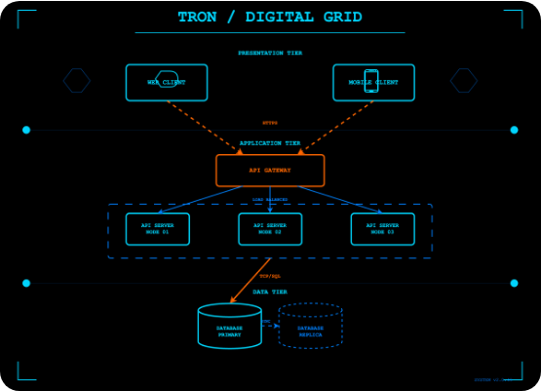
THE GUARDIAN DYNAMICS
Responsive Input
The player controls the "Guardian" basket using Mouse Motion or Keyboard (A-D/Arrows). Key features include:
▪
Catch Bounce: Visual spring effect on contact.
▪
Clamping: Precise screen-boundary logic.
▪
Aura Rendering: Real-time visual flags for active Magnet or Shield power-ups.

Slide 7

DIFFICULTY SCALING CURVE
Metric: Fall Speed (pixels per frame) vs Game Level.

Slide 8

SPAWNING PROBABILITY DISTRIBUTION

Slide 9
POWER-UP ARSENAL
Shield: Blocks 1 Voidling hit (6s duration).
Magnet: Automatically attracts Spawns to the basket.
Slow Time: Global 0.45x timescale for precision.
Multiplier: Doubles score gains via combo-stacking.

Slide 10






VISUAL FEEDBACK PIPELINE
Environment
FX Bursts
HUD Layer
Dynamic sky gradients that darken as the level increases.
Physics-driven particles generated on every successful catch.
Real-time combo tracking and life-count heart icons.

Slide 11
ENGINE FEATURES & PERSISTENCE
HighScoreManager: Robust file I/O that persists best scores to the user's home directory. Handles missing files gracefully without crashes.
Constants Architecture: Every tunable number (speed, radius, interval) is centralized for easy re-balancing.
Enum State Management: Clear distinction between Menu, Playing, Paused, and GameOver logic paths.

Slide 12


DEVELOPER PROFILE
Talha Yaseen
AI/ML Enthusiast | BSIT Batch '24
Punjab University Lahore, FCIT
Talha-Yaseen-Hub
Talha Yaseen | LinkedIn
talhavectorarts@gmail.com

Slide 13

QUESTIONS?
Thank you for exploring OmniDrop
github.com/Talha-Yaseen-Hub/Omni-Drop-Simulator-Java-Arcade

Slide 14






IMAGE SOURCES
https://robotpaper.ai/content/images/2026/02/image-16.png
Source: robotpaper.ai
https://images.stockcake.com/public/0/9/7/0971d6e6-2fca-41bd-800e-fd00db1a01ac_large/retro-arcade-shrine-stockcake.jpg
Source: stockcake.com
https://static.vecteezy.com/system/resources/previews/072/366/595/non_2x/monochrome-pixel-art-clouds-with-sparkling-stars-retro-digital-design-night-sky-fantasy-atmospheric-illustration-vector.jpg
Source: www.vecteezy.com
https://static.vecteezy.com/system/resources/thumbnails/067/796/168/small_2x/radiant-blue-light-burst-with-sparkling-particles-and-glowing-rays-on-dark-background-perfect-for-sci-fi-space-energy-or-futuristic-digital-effects-and-backgrounds-seamless-looping-animation-video.jpg
Source: www.vecteezy.com
https://static.vecteezy.com/system/resources/previews/055/713/833/non_2x/retro-90s-futuristic-game-hud-element-set-psychedelic-groovy-interface-decoration-aesthetic-geometric-trendy-y2k-ui-figure-design-space-frame-shape-collection-modern-blue-neon-symbol-graphic-vector.jpg
Source: www.vecteezy.com
https://img.magnific.com/premium-photo/hooded-figure-with-glowing-blue-glasses-shrouded-darkness-symbolizing-anonymity-technol_924727-111196.jpg?semt=ais_hybrid&w=740&q=80
Source: www.magnific.com

Slide 15

IMAGE SOURCES
https://images.unsplash.com/photo-1685914963658-11d4c18527c1?fm=jpg&q=60&w=3000&auto=format&fit=crop&ixlib=rb-4.1.0&ixid=M3wxMjA3fDB8MHxwaG90by1wYWdlfHx8fGVufDB8fHx8fA%3D%3D
Source: unsplash.com

